Slide 1
Report: Analyzing the Impact of Car Features on Price and Profitability
1. Project Description
The automotive industry has been rapidly evolving over the past few decades, with a growing focus on fuel efficiency, environmental sustainability, and technological innovation. With increasing competition among manufacturers and a changing consumer landscape, it has become more important to understand the factors driving consumer demand for cars. In recent years, there has been a growing trend towards electric and hybrid vehicles and increased interest in alternative fuel sources such as hydrogen and natural gas. At the same time, traditional gasoline-powered cars remain dominant in the market, with varying fuel types and grades available to consumers.
For the given dataset, as a Data Analyst, the client has asked: How can a car manufacturer optimize pricing and product development decisions to maximize profitability while meeting consumer demand?
By using data analysis techniques such as regression analysis and market segmentation, the manufacturer could develop a pricing strategy that balances consumer demand with profitability and identify which product features to focus on in future product development efforts. This could help the manufacturer maintain competitiveness in the market and increase its profitability over time.

Slide 2
Tasks: Analysis
1. How does the popularity of a car model vary across different market categories?
2. What is the relationship between a car's engine power and its price?
3. Which car features are most important in determining a car's price?
4. How does the average price of a car vary across different manufacturers?
5. What is the relationship between fuel efficiency and the number of cylinders in a car's engine?

Slide 3
Tasks: Dashboard
1. How does the distribution of car prices vary by brand and body style?
2. Which car brands have the highest and lowest average MSRPs, and how does this vary by body style?
3. How do the different feature such as transmission type affect the MSRP, and how does this vary by body style?
4. How does the fuel efficiency of cars vary across different body styles and model years?
5. How does the car's horsepower, MPG, and price vary across different Brands?

Slide 4
2. Approach
1. Understanding
Getting a thorough understanding of data and what impact it has on the target.
Cleaning
Handling irregularities in data for better analysis.
Analysis
Analyzing the data to draw insights and conclusions.
Visualization
Visualize the analysis and create a dashboard.

Slide 5
3. Tech-Stack Used
Microsoft Excel:
Data Cleaning
Data Analysis
Visualization
Dashboard

Slide 6
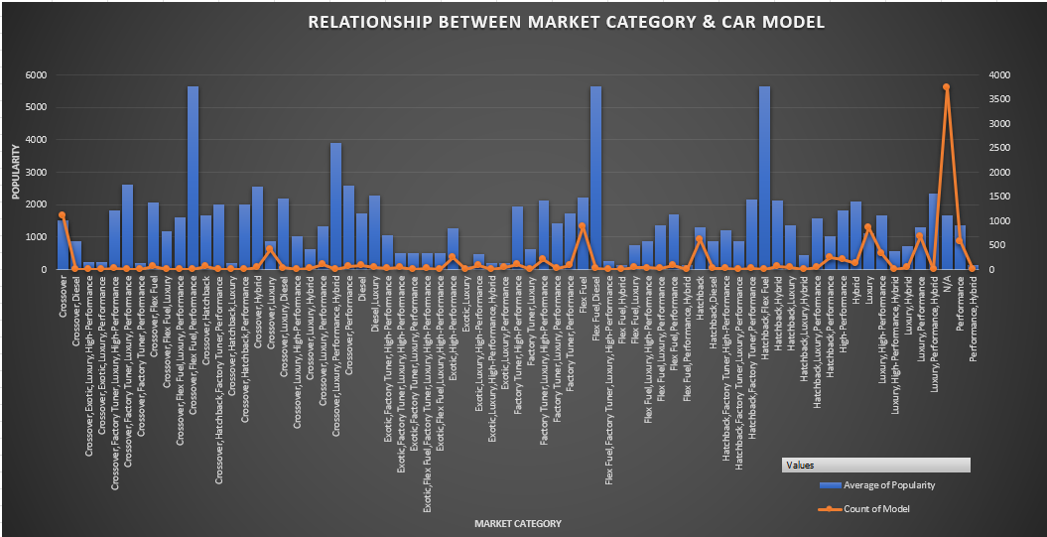
4. Insights
Task 1. How does the popularity of a car model vary across different market categories?

Slide 7
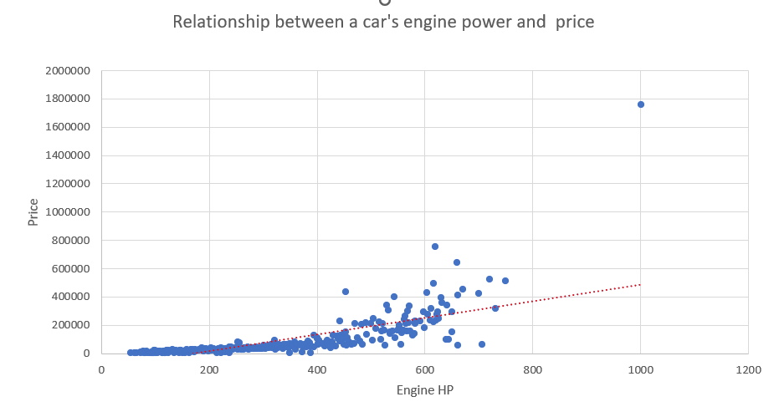
4. Insights
Task 2. What is the relationship between a car's engine power and its price?

Slide 8
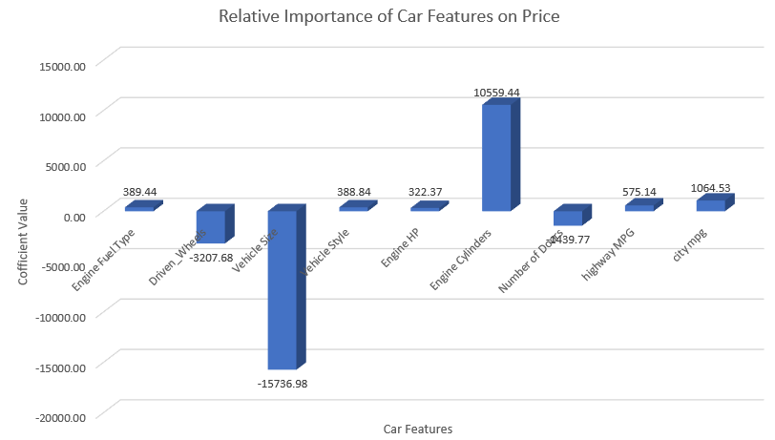
4. Insights
Task 3. Which car features are most important in determining a car's price?

Slide 9
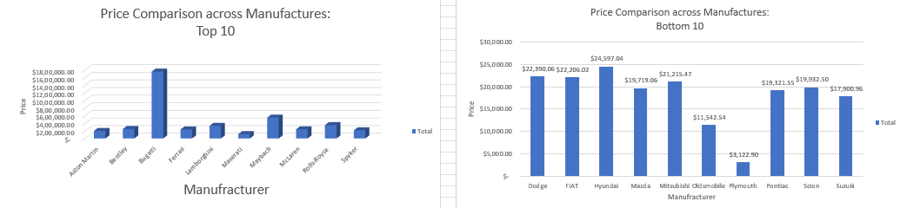
4. Insights
Task 4. How does the average price of a car vary across different manufacturers?

Slide 10
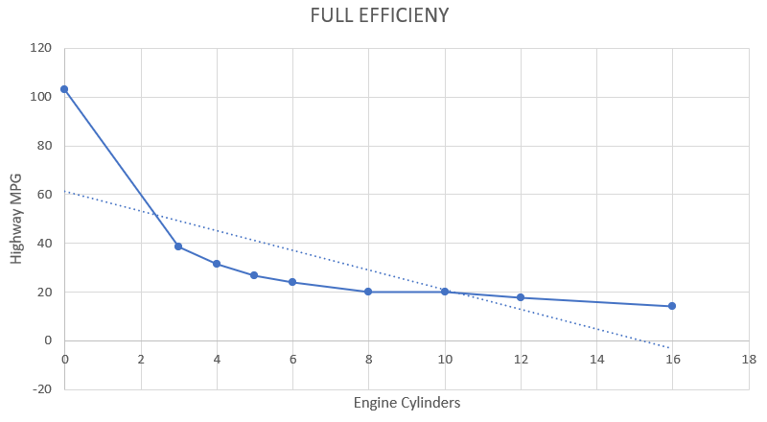
4. Insights
Task 5. What is the relationship between fuel efficiency and the number of cylinders in a car's engine?

Slide 11
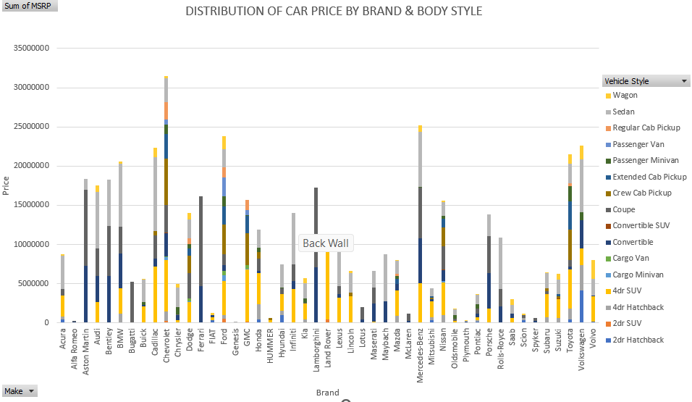
4. Dashboard
Task 1. How does the distribution of car prices vary by brand and body style?

Slide 12
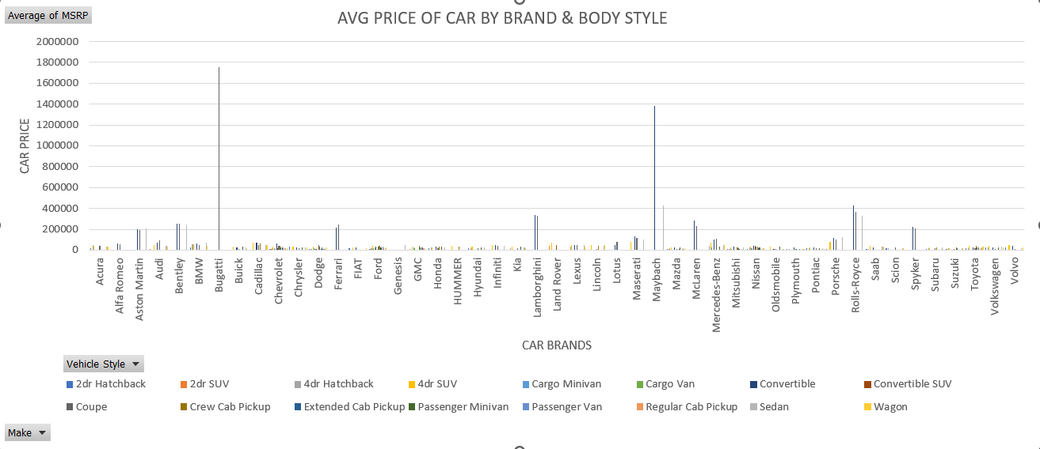
4. Dashboard
Task 2. Which car brands have the highest and lowest average MSRPs, and how does this vary by body style?

Slide 13
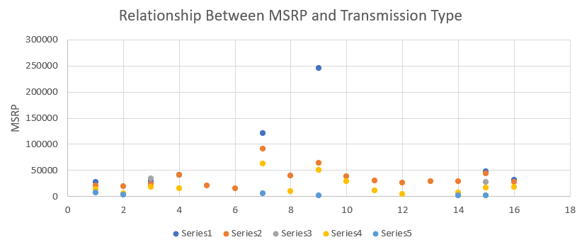
4. Dashboard
Task 3. Which car brands have the highest and lowest average MSRPs, and how does this vary by body style?

Slide 14
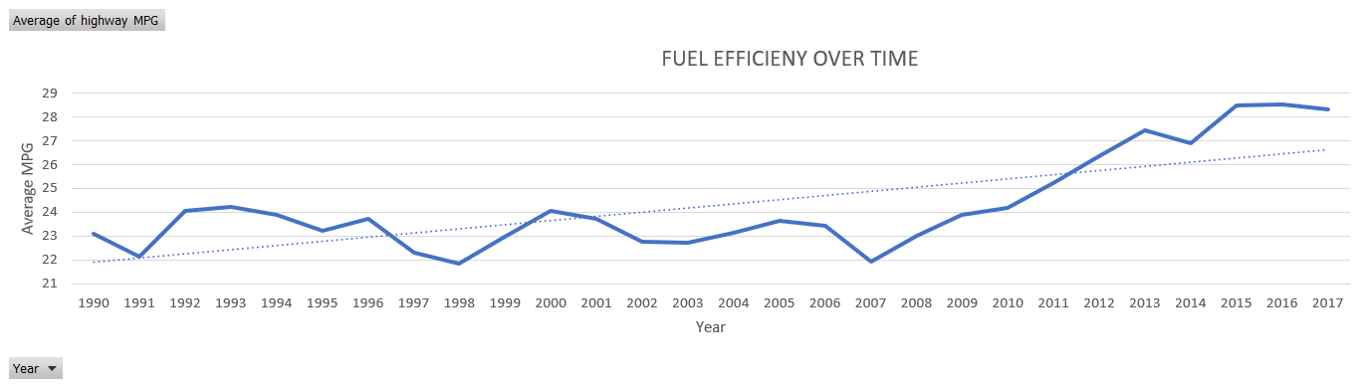
4. Dashboard
Task 4. How does the fuel efficiency of cars vary across different body styles and model years?

Slide 15
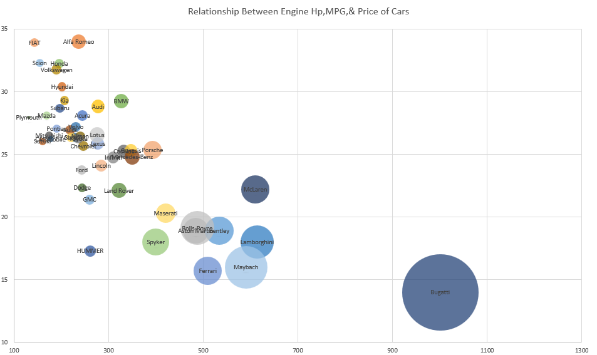
4. Dashboard
Task 5. How does the car's horsepower, MPG, and price vary across different Brands?

Slide 16
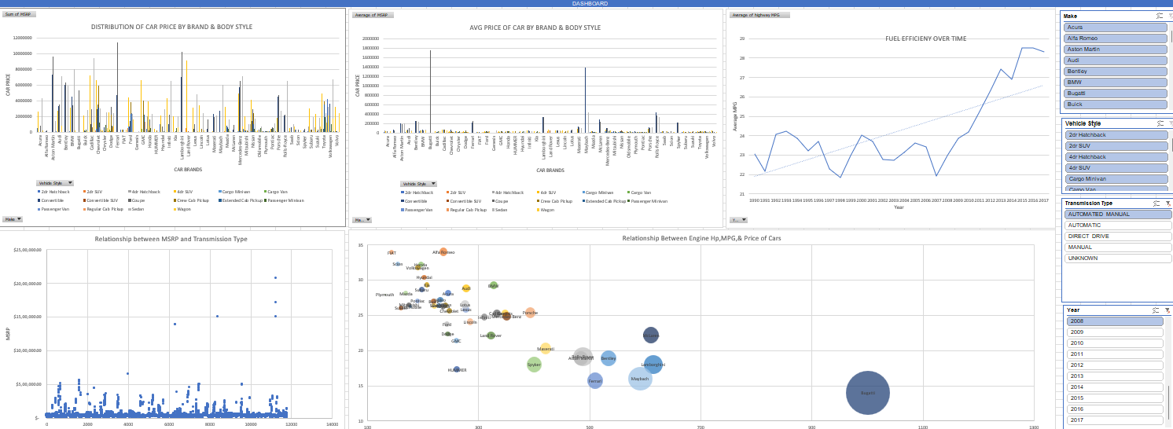
Dashboard

Slide 17
5. Result
The coupe body style has the hightest MSRP contribution
A single car with both automated and manual gear systems will be more advantageous than one gear system, hence the gearbox type automated_manual has a significate impact.
To enable the bulk of the class to afford a car, companies must create cars with high or at least fuel efficiently.
Excel file :Link
Video link : link

Slide 18
Thank You !

